Slide 1
Experimental Results
We have computed the algorithms and implemented it in our unreal engine environment using blueprints and C++ compatibility with unreal engine. And got the following results.
For the given Scenario the entire grid area is navigation mesh where the green box is the start node the orange box is the end node or the pawn, the grey nodes are obstacles. As you can see the start and end objects do fall under different nodes in navigation mesh. The derived path from different algorithms will be shown in blue in the upcoming diagrams.

Slide 2
Path by Dijkstra’s Algorithm
44 | 40 | 44 | 48 | 52 | 62 | 66 | 76 | 86 | 96
34 | 30 | 34 | 38 | 48 | 52 |  | 86 | 90
24 | 20 | 24 | 28 | 38 | 48 |  | 96
14 | 10 | 14 | 24 | 34 | 44 |  | 92 | 96
10 |  | 10 | 20 | 30 | 40 |  | 82 | 86 | 96
14 | 10 | 14 | 24 | 34 | 44 |  | 72 | 82 | 92
24 | 20 | 24 | 28 | 38 | 48 | 58 | 68 | 78 | 88
34 |  |  |  |  | 52 | 62 | 72 | 82 | 92
44 | 48 | 58 | 68 | 66 | 62 | 66 | 76 | 86 | 96
54 | 58 | 62 | 72 | 76 | 72 | 76 | 80 | 90

Slide 3
Path by greedy best-first search
 | 71 | 61 | 51 | 41 | 32
80 | 70 | 60 | 50 | 40 | 30 |  |  | 0
81 |  | 61 | 51 | 41 | 32 |  | 14 | 10 | 14
82 | 73 | 63 |  | 34 | 36 |  | 22 | 20
 |  |  |  | 38 | 42 | 36 | 31 | 30

Slide 4
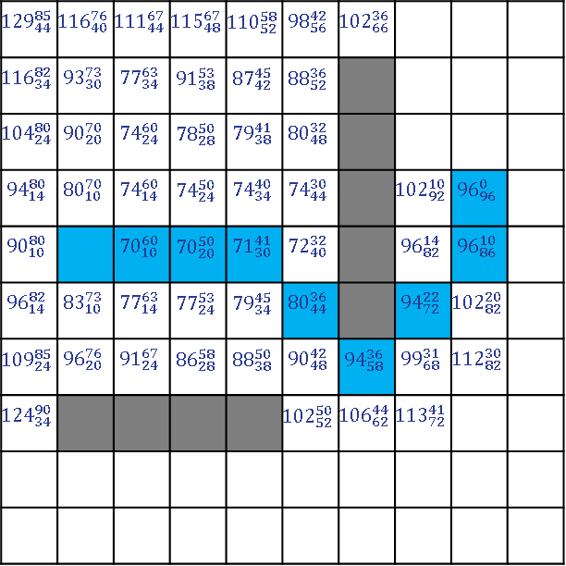
Path from A* Algorithm
$${129}_{44}^{85}$$ | $${116}_{40}^{76}$$ | $${111}_{44}^{67}$$ | $${115}_{48}^{67}$$ | $${110}_{52}^{58}$$ | $${98}_{56}^{42}$$ | $${102}_{66}^{36}$$
$${116}_{34}^{82}$$ | $${93}_{30}^{73}$$ | $${77}_{34}^{63}$$ | $${91}_{38}^{53}$$ | $${87}_{42}^{45}$$ | $${88}_{52}^{36}$$
$${104}_{24}^{80}$$ | $${90}_{20}^{70}$$ | $${74}_{24}^{60}$$ | $${78}_{28}^{50}$$ | $${79}_{38}^{41}$$ | $${80}_{48}^{32}$$
$${94}_{14}^{80}$$ | $${80}_{10}^{70}$$ | $${74}_{14}^{60}$$ | $${74}_{24}^{50}$$ | $${74}_{34}^{40}$$ | $${74}_{44}^{30}$$ |  | $${102}_{92}^{10}$$ | $${96}_{96}^{0}$$
$${90}_{10}^{80}$$ |  | $${70}_{10}^{60}$$ | $${70}_{20}^{50}$$ | $${71}_{30}^{41}$$ | $${72}_{40}^{32}$$ |  | $${96}_{82}^{14}$$ | $${96}_{86}^{10}$$
$${96}_{14}^{82}$$ | $${83}_{10}^{73}$$ | $${77}_{14}^{63}$$ | $${77}_{24}^{53}$$ | $${79}_{34}^{45}$$ | $${80}_{44}^{36}$$ |  | $${94}_{72}^{22}$$ | $${102}_{82}^{20}$$
$${109}_{24}^{85}$$ | $${96}_{20}^{76}$$ | $${91}_{24}^{67}$$ | $${86}_{28}^{58}$$ | $${88}_{38}^{50}$$ | $${90}_{48}^{42}$$ | $${94}_{58}^{36}$$ | $${99}_{68}^{31}$$ | $${112}_{82}^{30}$$
$${124}_{34}^{90}$$ |  |  |  |  | $${102}_{52}^{50}$$ | $${106}_{62}^{44}$$ | $${113}_{72}^{41}$$

Slide 5
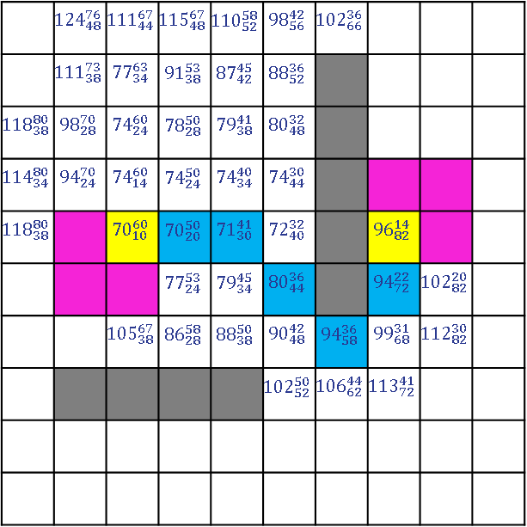
CentA* Algorithm Path
Starting node (which is AI)
Ending Node (our character)
Optimal start/end node
Derived path
Obstacles
 | $${124}_{48}^{76}$$ | $${111}_{44}^{67}$$ | $${115}_{48}^{67}$$ | $${110}_{52}^{58}$$ | $${98}_{56}^{42}$$ | $${102}_{66}^{36}$$
 | $${111}_{38}^{73}$$ | $${77}_{34}^{63}$$ | $${91}_{38}^{53}$$ | $${87}_{42}^{45}$$ | $${88}_{52}^{36}$$
$${118}_{38}^{80}$$ | $${98}_{28}^{70}$$ | $${74}_{24}^{60}$$ | $${78}_{28}^{50}$$ | $${79}_{38}^{41}$$ | $${80}_{48}^{32}$$
$${114}_{34}^{80}$$ | $${94}_{24}^{70}$$ | $${74}_{14}^{60}$$ | $${74}_{24}^{50}$$ | $${74}_{34}^{40}$$ | $${74}_{44}^{30}$$
$${118}_{38}^{80}$$ |  | $${70}_{10}^{60}$$ | $${70}_{20}^{50}$$ | $${71}_{30}^{41}$$ | $${72}_{40}^{32}$$ |  | $${96}_{82}^{14}$$
 |  |  | $${77}_{24}^{53}$$ | $${79}_{34}^{45}$$ | $${80}_{44}^{36}$$ |  | $${94}_{72}^{22}$$ | $${102}_{82}^{20}$$
 |  | $${105}_{38}^{67}$$ | $${86}_{28}^{58}$$ | $${88}_{38}^{50}$$ | $${90}_{48}^{42}$$ | $${94}_{58}^{36}$$ | $${99}_{68}^{31}$$ | $${112}_{82}^{30}$$
 |  |  |  |  | $${102}_{52}^{50}$$ | $${106}_{62}^{44}$$ | $${113}_{72}^{41}$$
After getting the destination from Unreal Engine Pawn Sensing component
First we will plot a grid in a game by plotting walkable and unwalkable nodes
And by using our CentA* algorithm we will derive a path for our AI to follow.

Slide 6
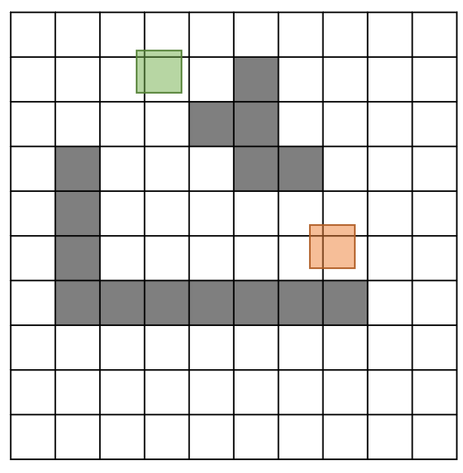
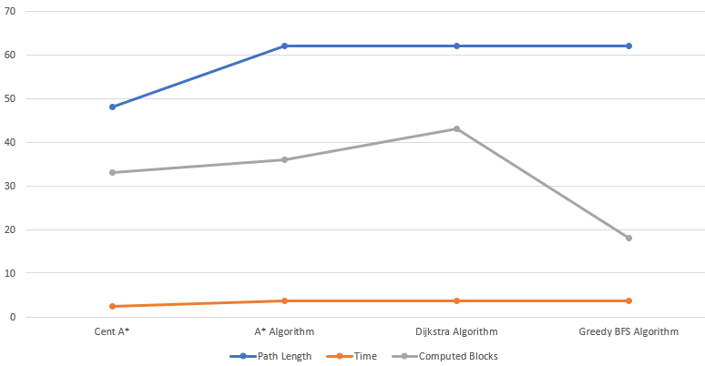
Result Analysis
Scenario 1
Component | Cent A* | A* Algorithm | Dijkstra Algorithm | Greedy BFS Algorithm
Path Length | 48 | 62 | 62 | 62
Time | 2.4 | 3.72 | 3.72 | 3.72
Computed Blocks | 33 | 36 | 43 | 18
Question
Results of Scenario 1

Slide 7
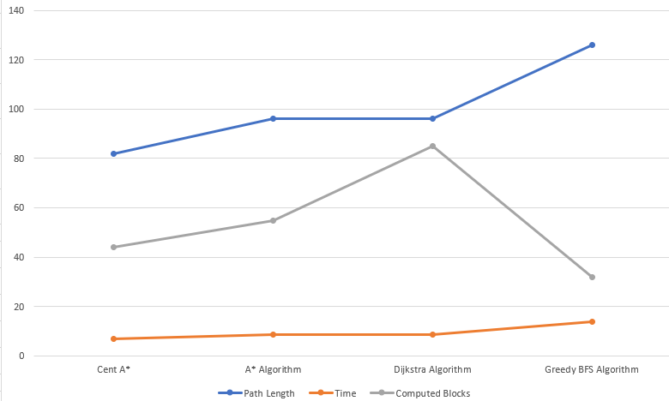
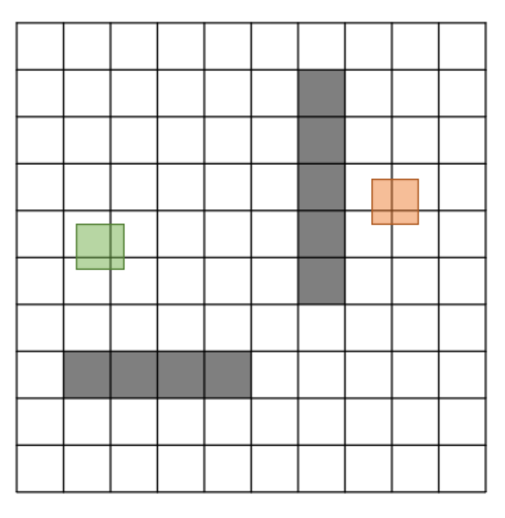
Result Analysis
Scenario 2
Component | Cent A* | A* Algorithm | Dijkstra Algorithm | Greedy BFS Algorithm
Path Length | 82 | 96 | 96 | 126
Time | 7.11 | 8.64 | 8.64 | 13.86
Computed Blocks | 44 | 55 | 85 | 32
Question
Results of Scenario 2

Slide 8
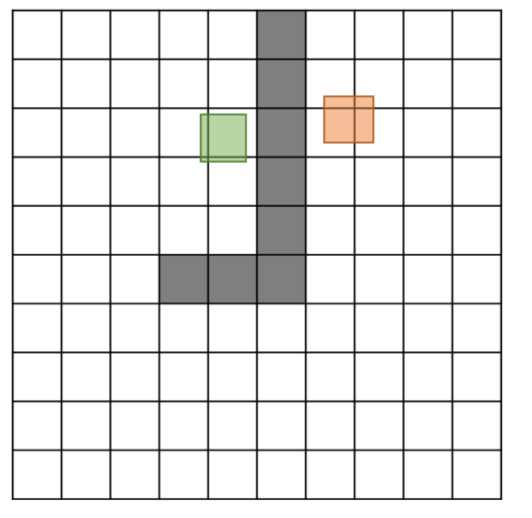
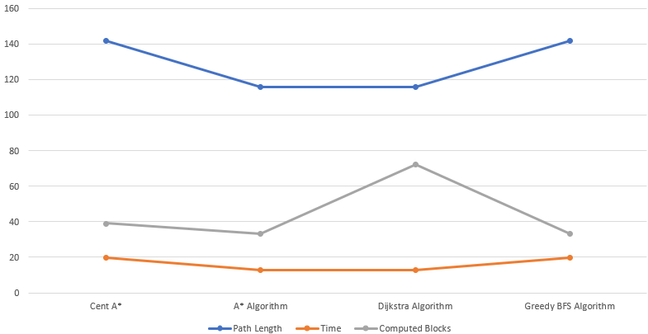
Result Analysis
Scenario 3
Component | Cent A* | A* Algorithm | Dijkstra Algorithm | Greedy BFS Algorithm
Path Length | 142 | 116 | 116 | 142
Time | 19.88 | 12.76 | 12.76 | 19.88
Computed Blocks | 39 | 33 | 72 | 33
Question
Results of Scenario 3

Slide 9
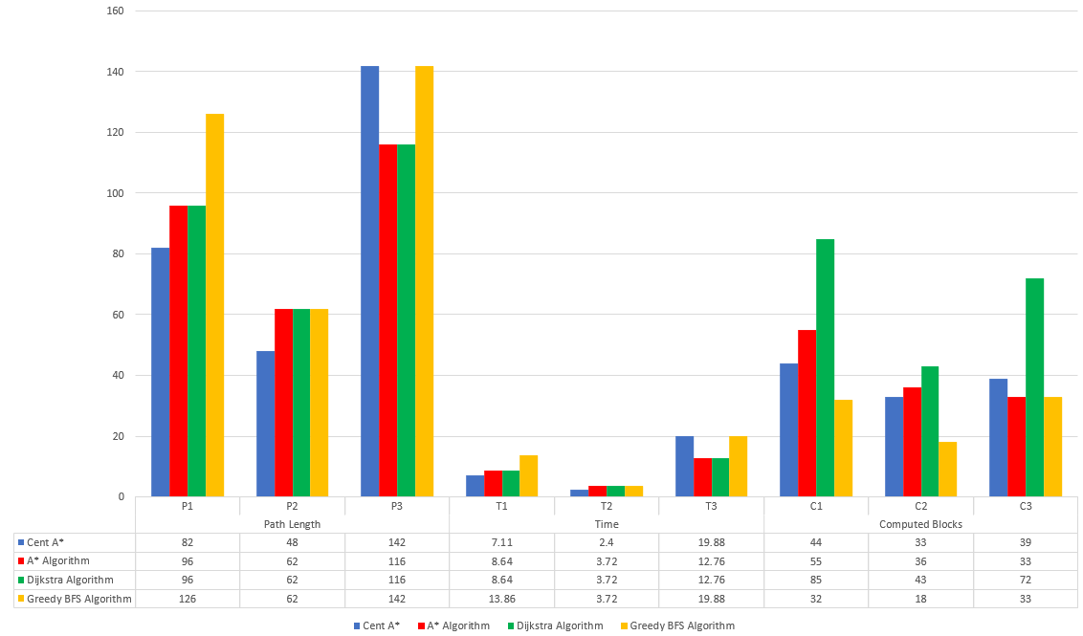
Result Analysis
Comparative study of all Scenarios

Slide 10
Conclusion
From the result got from the experiments we can compare our CentA* algorithm with different pathfinding algorithms Dijkstra’s Algorithm, Greedy Best-First and A* algorithm. The distance from the starting position is calculated using Dijkstra's Algorithm. The distance to the target location is estimated through avaricious Best-First Search. The total of the two distances is what A* is utilizing. And our algorithm is extending A* by providing it with more optimal start and end node.

